Slide 1
IMPLEMENTATION OF AN INTER AND INTRA DOMAIN PATH VECTOR ROUTING PROTOCOL

Slide 2
Overview
Implement an Intra-domain and Inter-domain path vector routing protocol.
The Intra-domain and Inter-domain routers communicate through UDP.

Slide 3
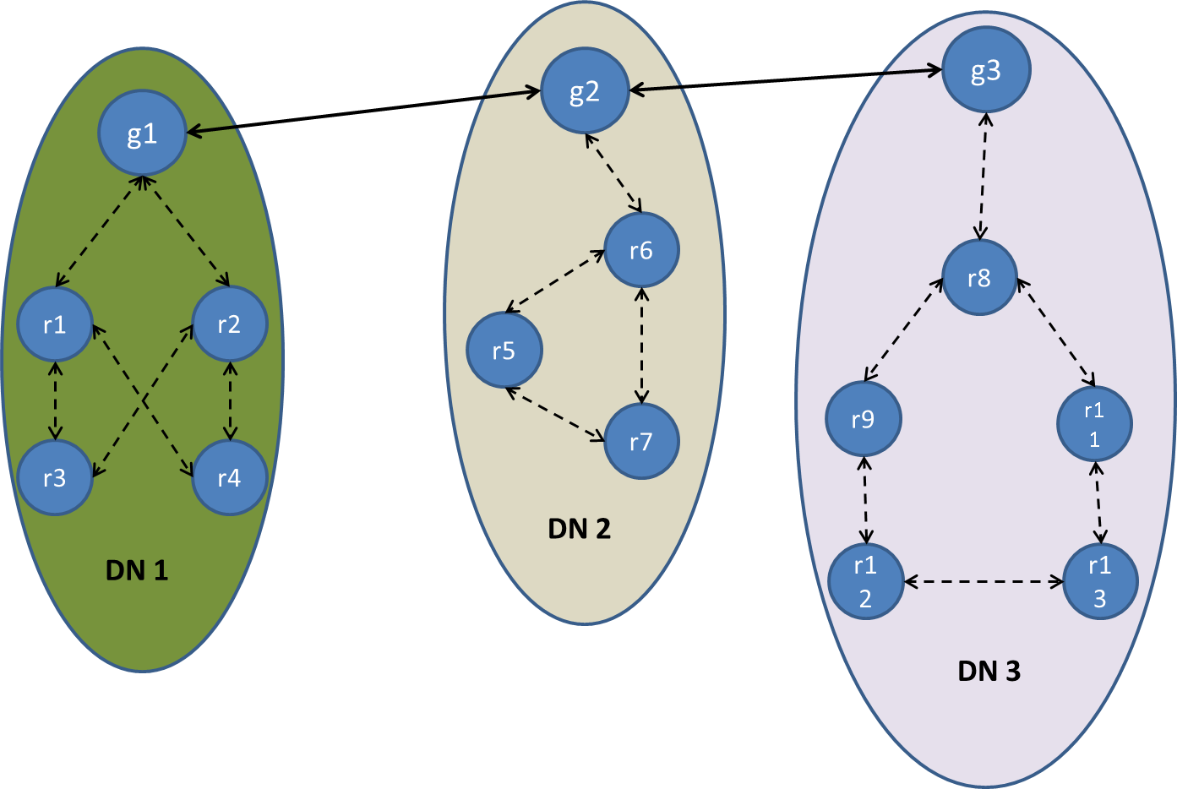
Topology

Slide 4
Topology Setup
Topology information can be retrieved from ConfigFile1
Contains details of how routers are connected to each other
Global topology configuration file format:
<Router ID,UDP Port,i/g>
Example:
<R1, 2932,i> <R2,2323,i> <G1,2392,g>
IP addresses for all routers will be specified in ConfigFile2

Slide 5
Route
Class
First Hop Type (i or g)
Path
Destination
Example:
{ i , “R2 R4”, R4} – route from R3 to R4
{ g , “G2 R6 R5”, R5} – route from G1 to R5

Slide 6
Message Format
Class
Destination Router
Source Router
Message Type
Message
Routing Info
Hello
Routing Info (Path)
Routing Info Request
Data
Withdraw
Error

Slide 7
Message Format
Examples:
Hello message from R1 to R2
{R2 , R1 , 1 , null , null}
Routing Info message from R3 to R4
{R4 , R3 , 2 , null , { i , “R2 R4”, R4} – route from R3 to R4}

Slide 8
Router
Class
Router ID
IP Address
UDP Port Number
Router Type ( i or g)
Route to IP Map (Map <Integer, String>)
Routing Table (Map <String, Arraylist<Route>>)
Domain ID

